Slide 1
Understanding Dyslexia: Assessment and Instruction
Ricky Flocken
Penny Duarte
Brianna Plum
Some content taken from presentation on 11/17/16 by Dr. Nancy Mather, Ph.D.

Slide 2
How Do You Describe Dyslexia??
Work in pairs to develop a definition…

Slide 3
International Dyslexia Association’s Definition of Dyslexia
“Dyslexia is a specific learning disability that is neurobiological in origin. It is characterized by difficulties with accurate and/or fluent word recognition and by poor spelling and decoding abilities. These difficulties typically result from a deficit in the phonological component of language that is often unexpected in relation to other cognitive abilities and the provision of effective classroom instruction. Secondary consequences may include problems in reading comprehension and reduced reading experience that can impede growth of vocabulary and background knowledge.”

Slide 4
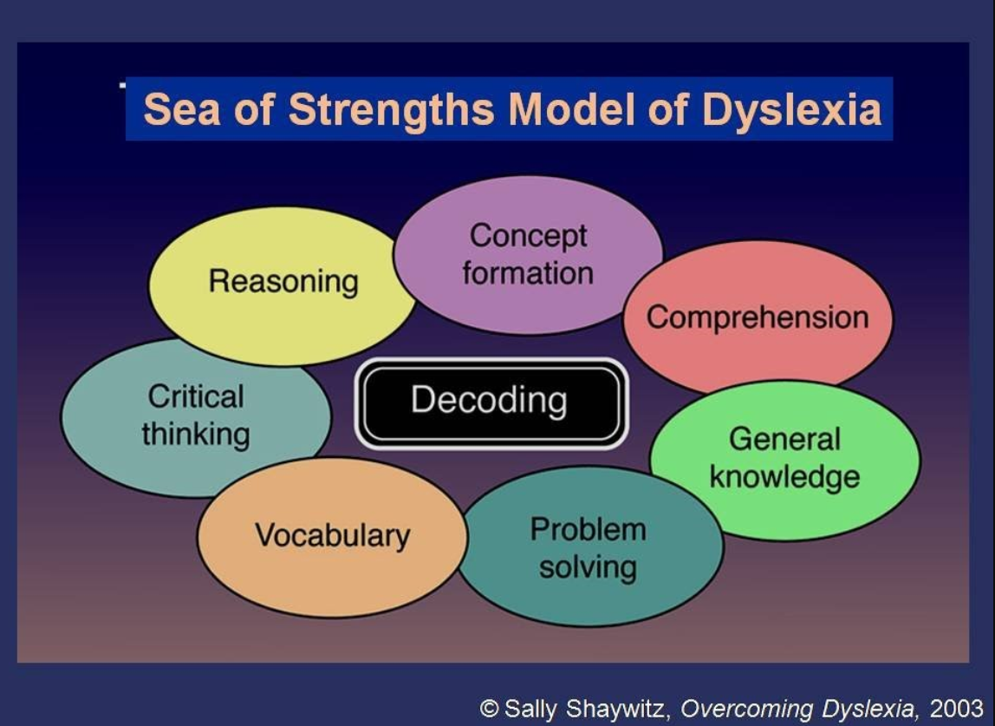
Notes:
Overcoming Dyslexia pg. 58

Slide 5
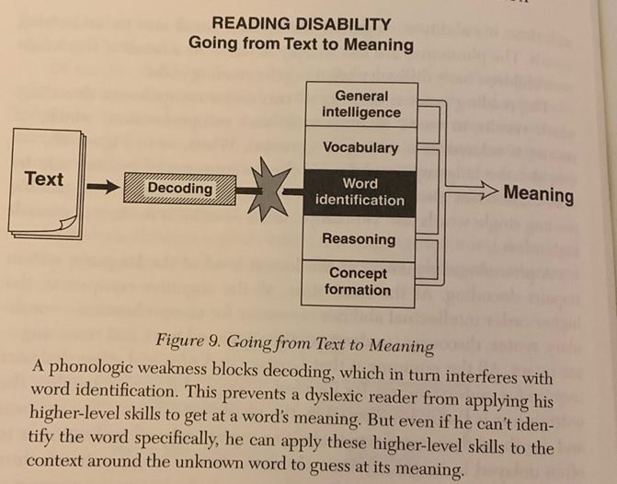
Sally Shaywitz, Overcoming Dyslexia, Pg. 54

Slide 6
Hereditary Factors
Strong converging evidence suggests that:
  Dyslexia has a genetic basis, but there is not one specific gene for reading
  Different regions of the brain are involved
  Family history is a key risk indicator

Slide 7
What Processing Areas Are Directly Linked to Dyslexia?
Work in groups to identify key processing areas…

Slide 8
Cognitive Factors Implicated in Dyslexia
Phonological Processing
Orthographic Processing
Rapid Automatized Naming
(Other cognitive factors often associated with dyslexia include: processing speed, working memory, and associative memory)
(High comorbidity with ADHD)

Slide 9
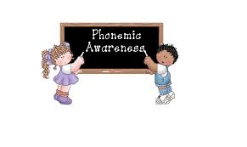
Phonological Awareness
Knowing that spoken language is composed of sounds
The ability to manipulate and integrate language sounds

Slide 10
Examples of Phonological
Awareness Tasks
Rhyming: What words rhyme with dog?
Blending: What word is this…/sh/ /oe/?
Phoneme Counting: How many sounds are in the word “ship”?
Phoneme Deletion: What is left if the /t/ sound were taken from “cart”?
Phoneme Segmentation: How many sounds do you hear in the word “bus”?

Slide 11
The Two Most Important Phonological Awareness Abilities
Sound Blending: provides the basis for learning phonics
Segmentation: provides the basis for sequencing sound when spelling

Slide 12
Poor Phonological Processing
May have:
  Early articulation errors
  Confusion of similar sounds (e.g., /b/, /p/, and /f/, /v/)
  History of ear infections
  Trouble learning letter sounds
  Poor nonword repetition, reading, and spelling

Slide 13
Sequence of Skill Development
Discriminating rhymes
Producing rhymes
Isolating initial and final sounds
Blending sounds
Segmenting sounds
Manipulating sounds (e.g., deleting, substituting, transposing)
90% of students can do this by the end of 2nd grade
Notes:
FAR: 2nd grade is learning to read, 3rd grade is reading to learn

Slide 14

Phonological Awareness Development
K-1st: rhyming, blending and segmenting compound words and multisyllabic words
1st-2nd: segmenting and blending phonemes; manipulating the initial, final and the middle sound

Slide 15
Phonology and Orthography
Dyslexia can be caused by problems in phonology or orthography or both.
Phonology- the sounds of the language
Orthography- the marks of a writing system including the spelling patterns

Slide 16
Dr. Steven Feifer

Slide 17

Orthographic Processing
The ability to use common letter sequencing and spelling patterns to access stored words without sounding them out.

Slide 18
You may sound out the word, but that doesn’t give you enough information to know if the word is spelled correctly.
How do you know the correct spelling? rain or rane soap or sope

Slide 19
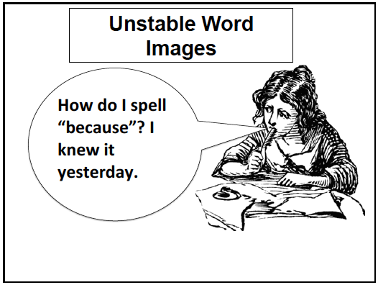

Slide 20
Students With Poor Orthographic Processing and Reading Might…
Have trouble remembering sight words
Continue to sound out words after many exposures
Confuse similar looking letters and words (e.g., on and no)
Have a slow word perception and reading rate

Slide 21
Student With Poor Orthographic Processing in Spelling Might…
Have difficulty learning how to form letters
Have trouble copying
Spell words the way they sound, not the way they look
Spell the same word inconsistently
Violate rules of English spelling
Have poor spelling into adulthood

Slide 22
What are the five ways to spell the speech sound /f/?
_____
_____
_____
_____
_____

Slide 23
f
ff
ph
gh
lf

Slide 24
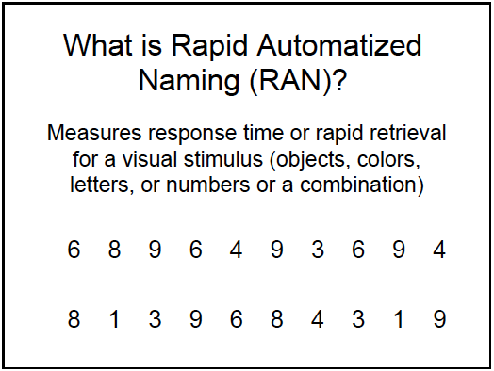

Slide 25
What Do Rapid Naming Tests Appear to Measure?
Ability to sustain attention to process and name the symbols
Ability to name and discriminate among the symbols
Ability to retrieve verbal labels rapidly
Ability to articulate words rapidly

Slide 26
What Do We Know about Rapid Naming?
Appears to be distinct from Phonology
Predicts word-reading accuracy and speed in many languages
Predicts irregular word reading better than non-word reading
Predicts poor reading across the lifespan

Slide 27
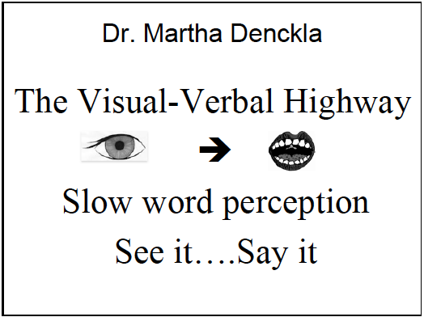
Notes:
Example of seeing a phone number and saying it to remember (before putting it in our phones)

Slide 28
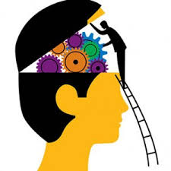
Other Cognitive Factors Contributing to Dyslexia

Slide 29
Processing Speed
Involves the scanning of print
Can be related to poor attention, slow rapid automatic naming, poor orthography, inefficient visual tracking
Appears related to the development of automaticity with basic skills (reading and math facts)

Slide 30
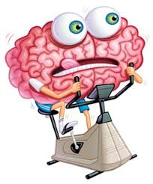
Working Memory
Ability to hold information in memory and rearrange it
Related to attention and executive functioning
Affects many aspects of academic performance

Slide 31
Associative Memory
Subset of long-term memory
Defined as the ability to learn and remember the relationship between unrelated items
Tasks typically require a student to learn associations between visual pictures and verbal labels
Items learned at the beginning of the task need to be recalled throughout the task
Affects many academic areas, including reading achievement, written expression, math calculation, math problem solving, listening comprehension, and oral expression

Slide 32
What Is the Difference Between Phonemic Awareness and Phonics?
Discuss in groups…

Slide 33
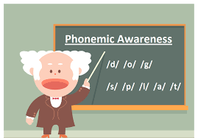
Phonemic Awareness
Phonemic awareness is the ability to notice, think about, and work with the individual sounds in words

Slide 34
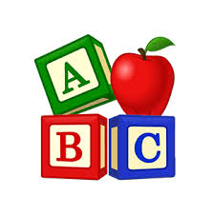
Phonics
Phonics is a method of teaching people to read by correlating sounds with letters or groups of letters in an alphabetic writing system

Slide 35
Poor Readers Have Difficulties With…
Learning how to blend (put together) and segment (take apart) the sounds in words
Learning sound (phoneme) and letter (grapheme) correspondences.

Slide 36
Early Predictors of Reading
The 2 best early predictors of how well children will learn to read during the first two years of school are:
  Phonemic Awareness
  Letter/Sound Knowledge (Phonics)
Ehri, L. (2000). National Reading Panel.

Slide 37
Phonemes
Basic building blocks of speech
Single speech sound
Distinguishes one word from another
Signifies a change in meaning

Slide 38
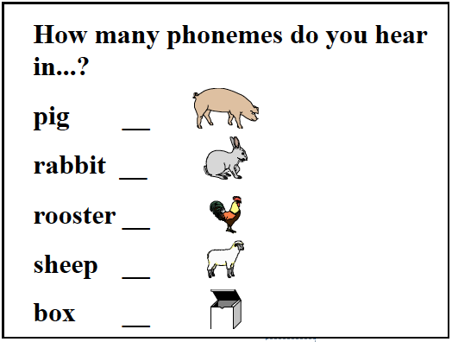

Slide 39
Pig 3
Rabbit 5
Rooster 5
Sheep 3
Box 4

Slide 40
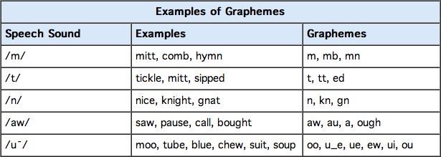
Grapheme
Individual letters and groups of letters that represent single phonemes, like the “s” and the “oo” in “spoon.”

Slide 41
Phoneme vs. Grapheme
The same grapheme can represent different phonemes (e.g. chair, character, chute)
The same phoneme may have a variety of graphemes (e.g. sure, sugar, ship, machine, motion, and special)
Knowledge of phoneme-grapheme relationships is needed for skilled reading and spelling
Notes:
What is the phoneme for #2
“sh”

Slide 42
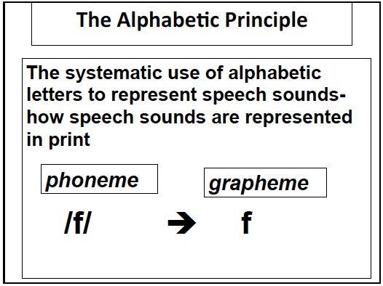
Notes:
Knowledge of the predictable relationships between written letters and spoken sounds

Slide 43
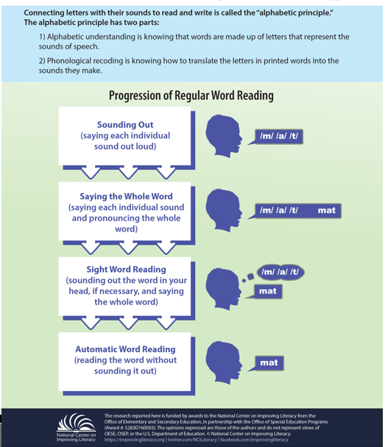

Slide 44
Reading vs. Spelling/Writing
Decoding:
  The process of reading words in text
  It is necessary to understand what the letters are, the sounds made by each letter, and how they blend together to create words
Encoding:
  The process of using letter/sound knowledge to write
  It is necessary to recall sounds and the symbols assigned to them to write the letters together to form words

Slide 45
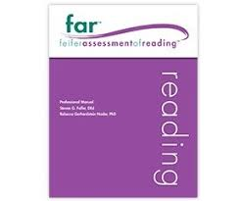


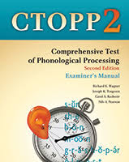
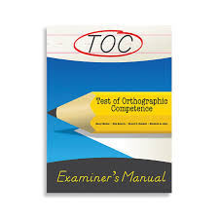
Dyslexia Assessments

Slide 46
Many students with specific reading disabilities have poor phonological awareness and difficulty connecting sounds to print which results in slow word perception, a delay in developing instant word reading, and poor spelling.

Slide 47
Cognitive/Processing Assessments
Phonological Processing
  CTOPP-2
  FAR
  WJ-IV COG
  TAPS-4
Orthographic Processing
  FAR
  TOSWRF-2
  TOC
  PAL-2
Rapid Automatized Naming
  CTOPP-2
  FAR
  WISC-V

Slide 48
Academic Assessments
Be sure to assess the following:
  Decoding Skills (i.e. real and nonsense words, phonetically regular and irregular)
  Reading Fluency
  Spelling
Other academic areas that may be impacted:
  Reading Comprehension
  Math Problem Solving
  Written Expression

Slide 49
Things to Remember
Oral language and reasoning abilities are often more advanced than basic reading skills
Reading disabilities affect the IQ score
Small group instruction is effective
Reading problems affect emotional well being

Slide 50
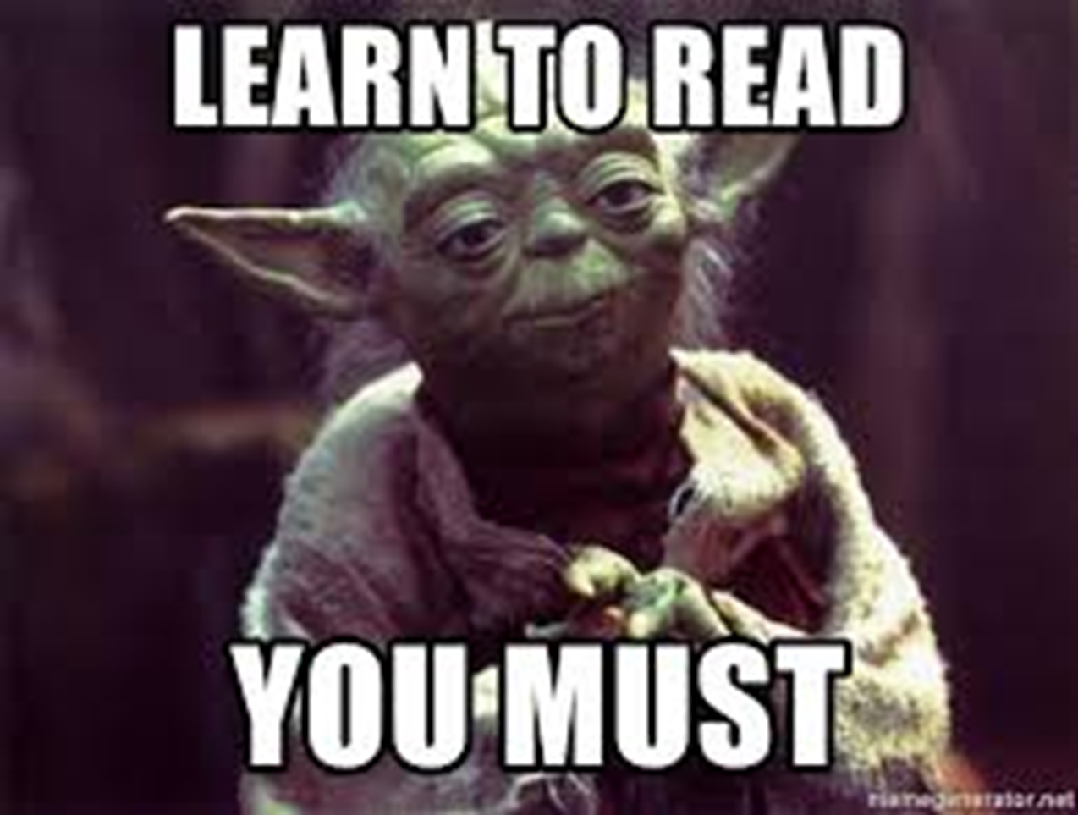
“The greatest endeavor a person will endure in their lifetime is learning to read”
The human brain is wired to speak, not to read”

Slide 51
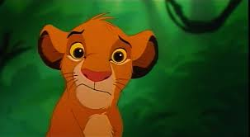
Questions?

